Slide 1
Exploratory Data analysis
Milestone -2

Slide 2
Scenario & Objective
Scenario: A Fast Moving Consumer Goods (FMCG) company has entered into the instant noodles business two years back. Their higher management has notices that there is a miss match in the demand and supply. Where the demand is high, supply is pretty low and vice-versa which as a result as a loss in inventory cost and ultimately loss to the company. Hence, the higher management wants to optimize the supply quantity in each and every warehouse in entire country.
Goal & Objective: The objective of this exercise is to build a model, using historical data that will determine an optimum weight of the product to be shipped each time from the respective warehouse.

Slide 3
Dataset Description
Dataset has 22150 rows and 24 columns.
Out of 24 columns there are :
6 columns are having categorical type of data.
16 columns are having numerical or continuous type of data.
Following columns have null values:
wh_est_year
approved_wh_govt_certificate
workers_num
There are no duplicates in the data.

Slide 4
Data Quality Issues
After performing the outlier detection treatments it was seen that following columns have outlier's:
workers_num
transport_issue_l1y
Competitor_in_mkt
retail_shop_num
Wh_est_year(warehouse establishment year) has about 47% null values.

Slide 5
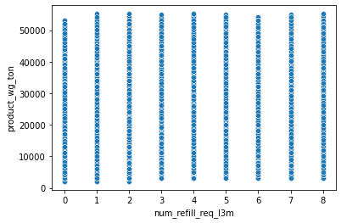
num_refill_req_l3m vs product_wg_ton
0
Null hypothesis(H0): There is no correlation between the variables in the population.
Alternative Hypothesis(H1): There is correlation between the variables in the population.
After performing pearsonr correlation test, we obtained values as follows:
Correlation_strength =0.00067
P_value = 0.9198
Since p_value is very high we cannot reject null hypothesis, hence we can conclude these two variables are not linearly correlated.

Slide 6
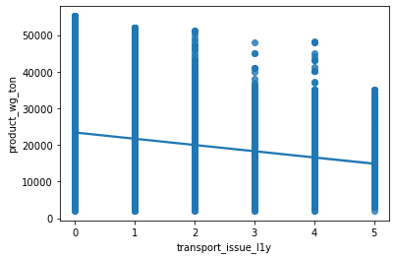
transport_issue_l1y vs product_wg_ton
0
Null hypothesis(H0): There is no correlation between the variables in the population.
Alternative Hypothesis(H1): There is correlation between the variables in the population.
After performing pearsonr correlation test, we obtained values as follows:
Correlation_strength =-0.1757
P_value = 0.00
Since p_value is very low we can reject null hypothesis, hence we can conclude there is some linear correlation between these two variables.

Slide 7
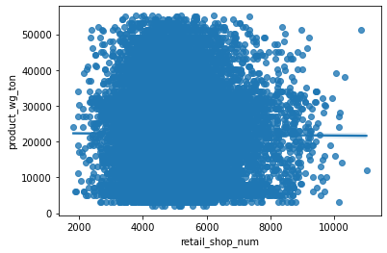
retail_shop_num vs product_wg_ton
0
Null hypothesis(H0): There is no correlation between the variables in the population.
Alternative Hypothesis(H1): There is correlation between the variables in the population.
After performing pearsonr correlation test, we obtained values as follows:
Correlation_strength =-0.00678
P_value = 0.3125
Since p_value is very high we cannot reject null hypothesis, hence we can conclude there is no linear correlation between these two variables.

Slide 8
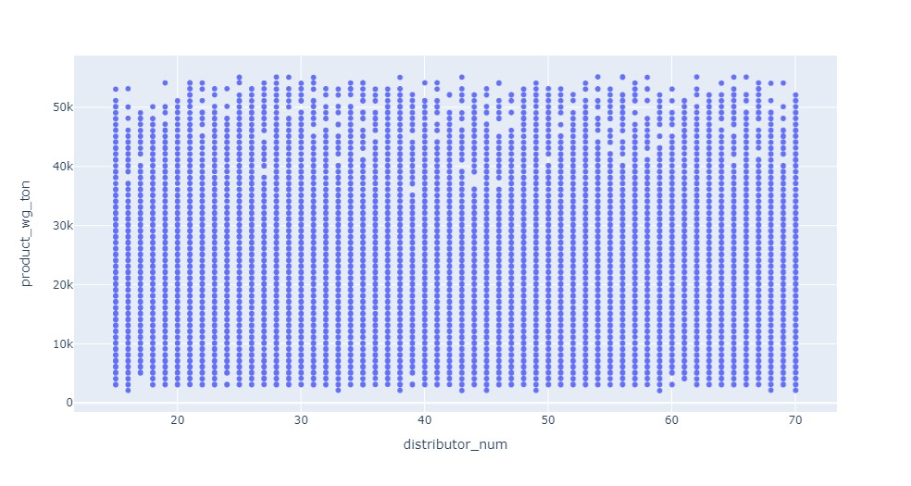
distributor_num vs product_wg_ton
0
Null hypothesis(H0): There is no correlation between the variables in the population.
Alternative Hypothesis(H1): There is correlation between the variables in the population.
After performing pearsonr correlation test, we obtained values as follows:
Correlation_strength =-.00514
P_value = 0.444
Since p_value is very high we cannot reject null hypothesis, hence we can conclude there is no linear correlation between these two variables.

Slide 9
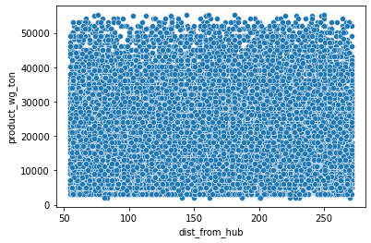
dist_from_hub vs product_wg_ton
0
Null hypothesis(H0): There is no correlation between the variables in the population.
Alternative Hypothesis(H1): There is correlation between the variables in the population.
After performing pearsonr correlation test, we obtained values as follows:
Correlation_strength =-0.00604
P_value = 0.3687
Since p_value is very high we cannot reject null hypothesis, hence we can conclude there is no linear correlation between these two variables.

Slide 10
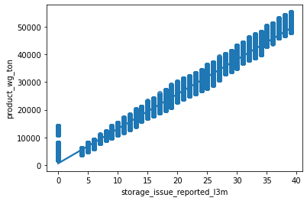
storage_issue_reported_l3m vs product_wg_ton
0
Null hypothesis(H0): There is no correlation between the variables in the population.
Alternative Hypothesis(H1): There is correlation between the variables in the population.
After performing pearsonr correlation test, we obtained values as follows:
Correlation_strength = 0.986
P_value = 0.0
Since p_value is very low so we can reject null hypothesis, hence we can conclude there is a strong linear correlation between these two variables.

Slide 11
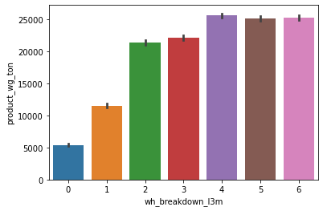
wh_breakdown_l3m vs product_wg_ton
0
Null hypothesis(H0): There is no correlation between the variables in the population.
Alternative Hypothesis(H1): There is correlation between the variables in the population.
After performing pearsonr correlation test, we obtained values as follows:
Correlation_strength = 0.3436
P_value = 0.0
Since p_value is very low so we can reject null hypothesis, hence we can conclude there is a linear correlation between these two variables.

Slide 12
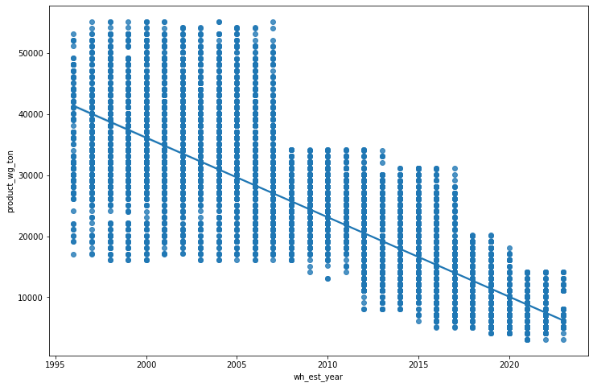
wh_est_year vs product_wg_ton
0
Null hypothesis(H0): There is no correlation between the variables in the population.
Alternative Hypothesis(H1): There is correlation between the variables in the population.
After performing pearsonr correlation test, we obtained values as follows:
Correlation_strength = -0.828
P_value = 0.0
Since p_value is very low so we can reject null hypothesis, hence we can conclude there is a linear correlation between these two variables.

Slide 13
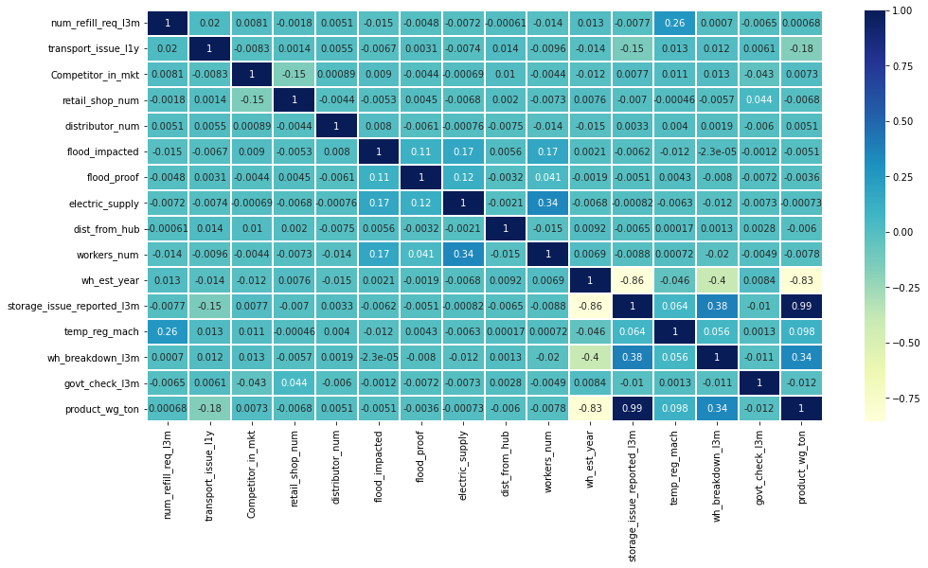
Heat Map

Slide 14
Categorical Columns
To check the corelation between categorical variable and continuous variable, we use modified person corelation test called Point bi serial test.
Results of Point bi serial test are as follows:
Features | correlation_strenght
Location_type_Urban | 0.074158
wh_owner_type_Rented | 0.003412
flood_impacted | -0.005055
flood_proof | -0.003567
electric_supply | -0.000725
temp_reg_mach | 0.098452

Slide 15
Summary
There are missing values in some columns that need to imputed or we need can remove those columns.
There are outlier's that need to be removed from few columns.
Since most of the columns don’t have linear relationship with target column, Tree based algorithms may be a good choice.

